Slide 1





Who is the Buddha?
Dr Naomi Appleton
University of Edinburgh, naomi.appleton@ed.ac.uk
Dr Chris Jones
University of Cambridge, cvj20@cam.ac.uk

Slide 2
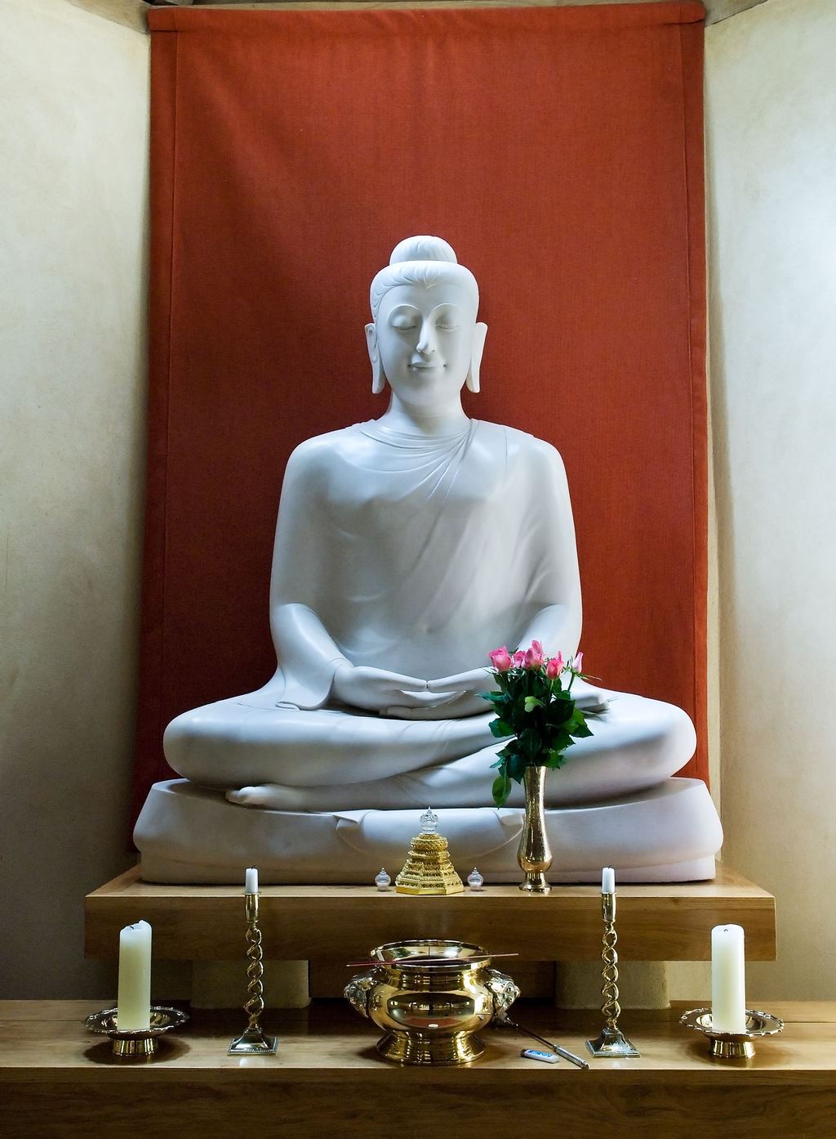
Programme
January 27th The Buddha: Historical Figure or Literary Character?
February 3rd The Buddha as Philosopher
February 17th The Buddha as Social Reformer
February 24th The Buddha in Buddhist Practice
March 10th The Buddha among Buddhas
March 17th The Buddha in Modern Britain
Each session will consist of roughly 45 minutes of presentation, and up to 30 minutes of questions and/or discussion.
The presentations (though not the discussions) will be recorded. Please keep cameras off during this part of the event.
Notes:
In the slide is the main altarpiece at the Chithurst Buddhist Monastery, a monastery in the Thai Forest Tradition, in West Sussex, discussed later on in this session.
The image is free to use, and sourced here: https://en.wikipedia.org/wiki/Chithurst_Buddhist_Monastery#/media/File:Main_Buddha_Chithurst_Cittaviveka.png.

Slide 3
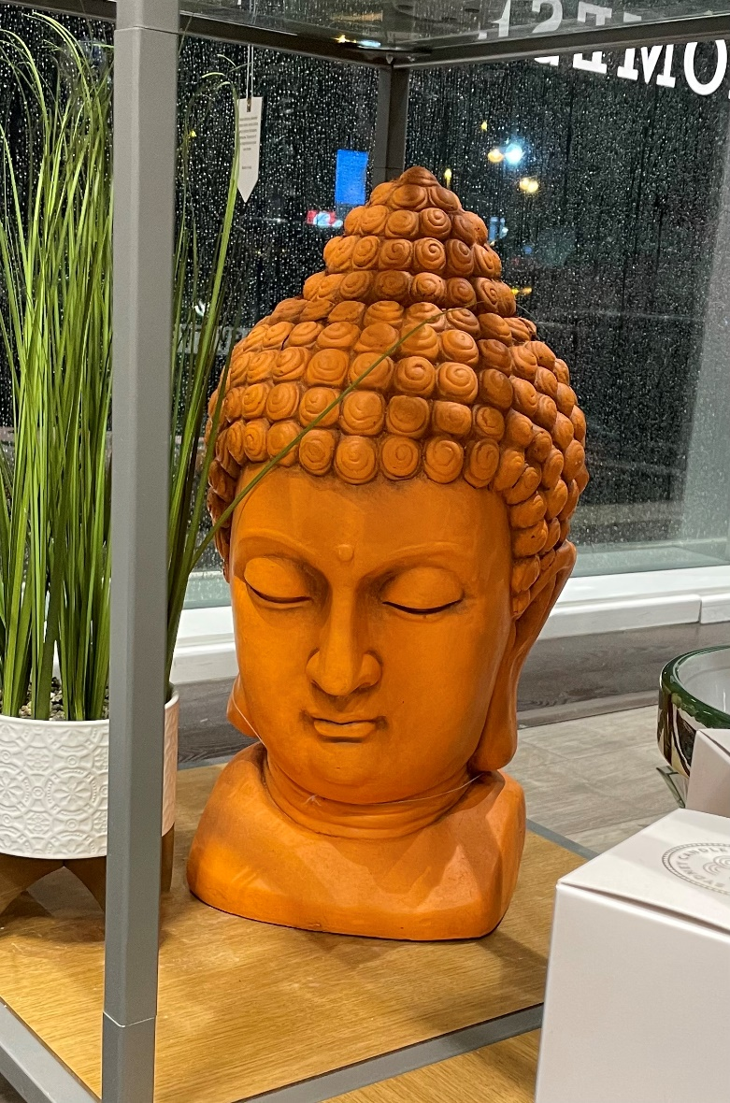
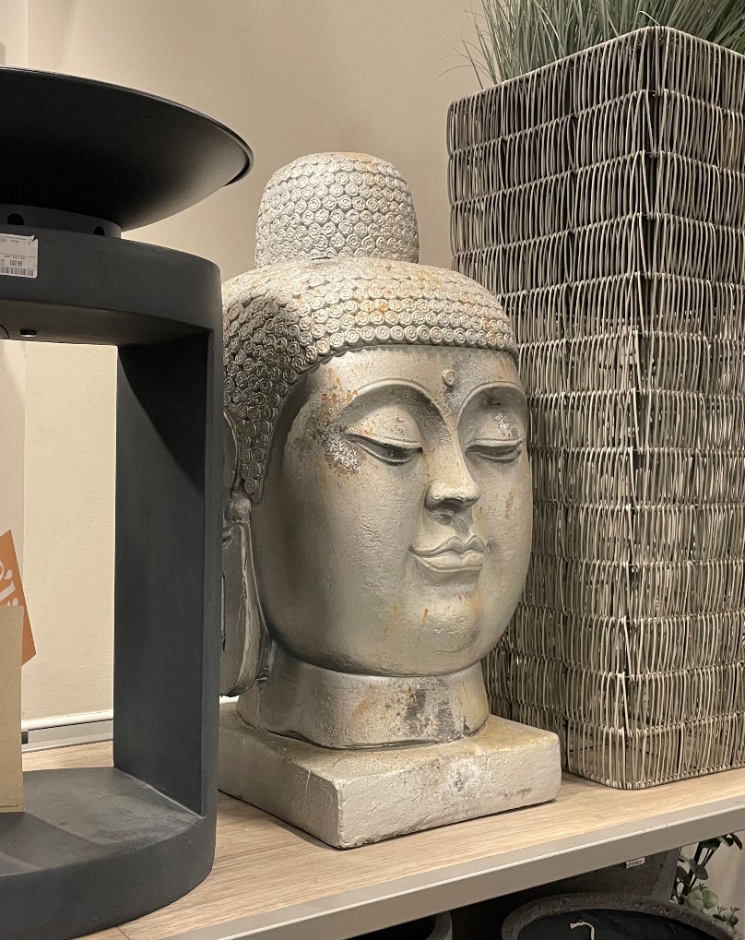
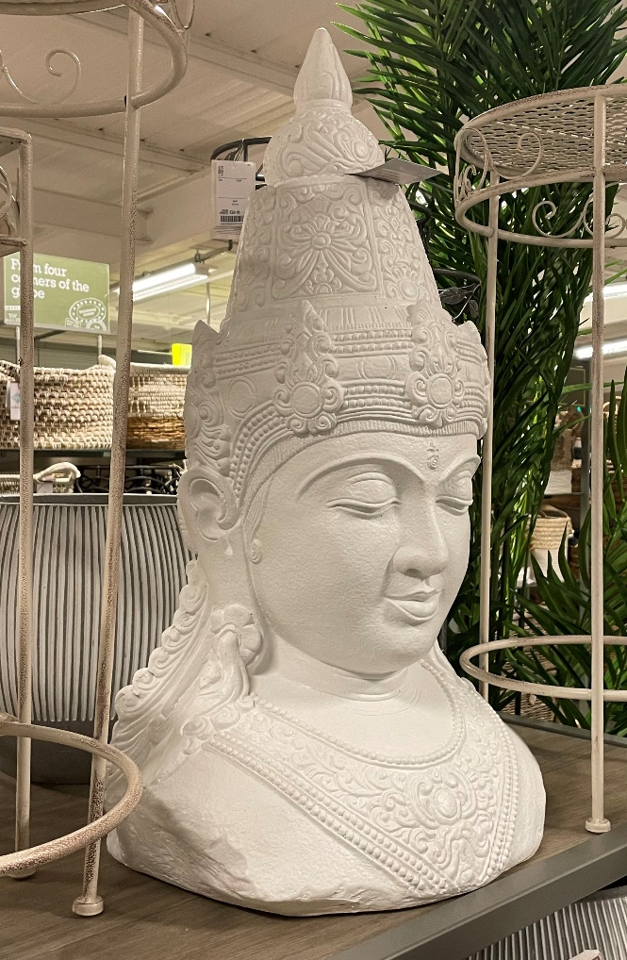
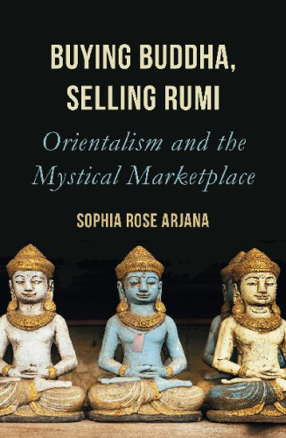
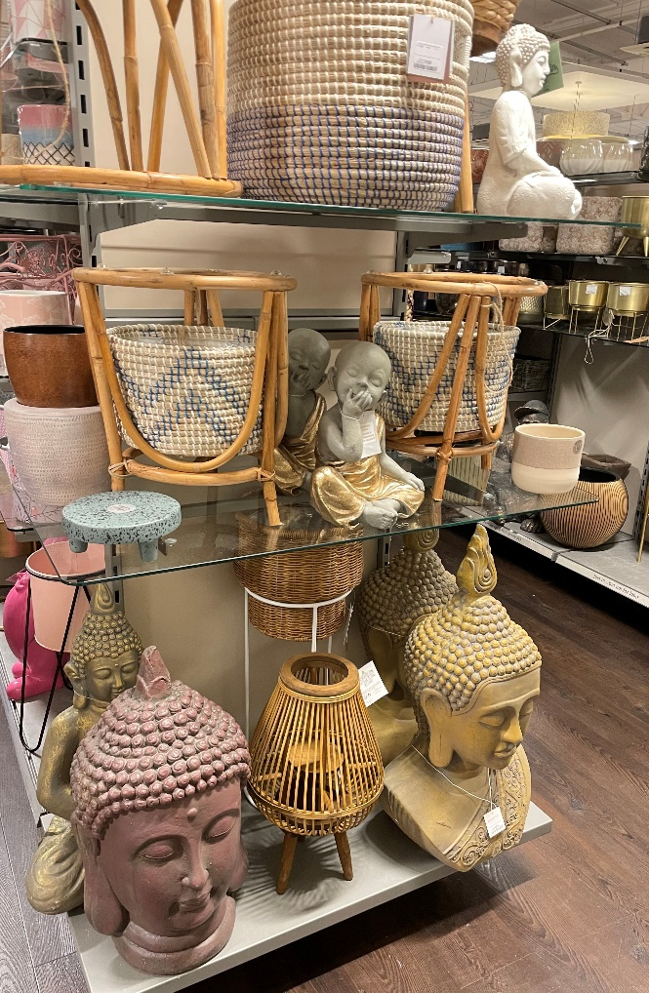
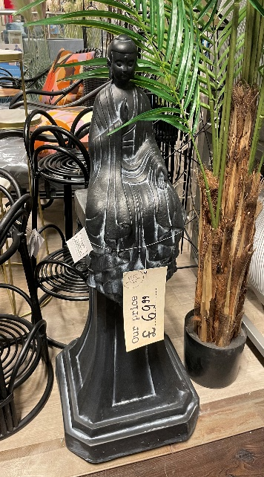
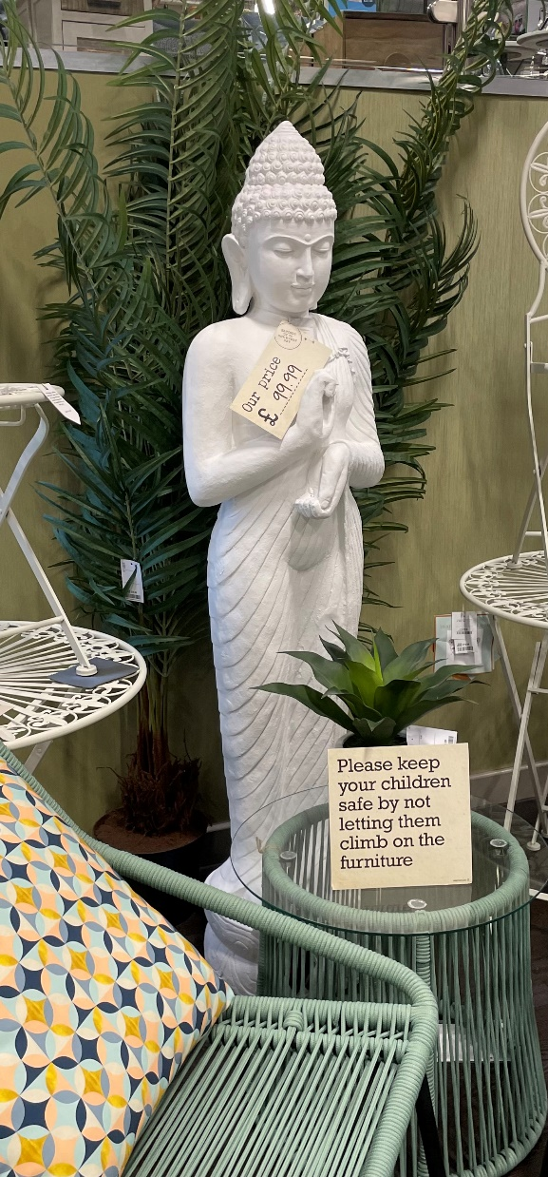
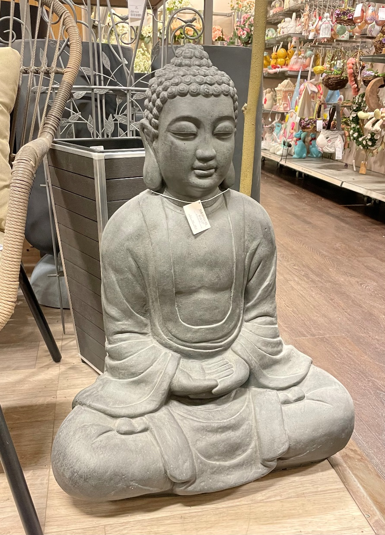
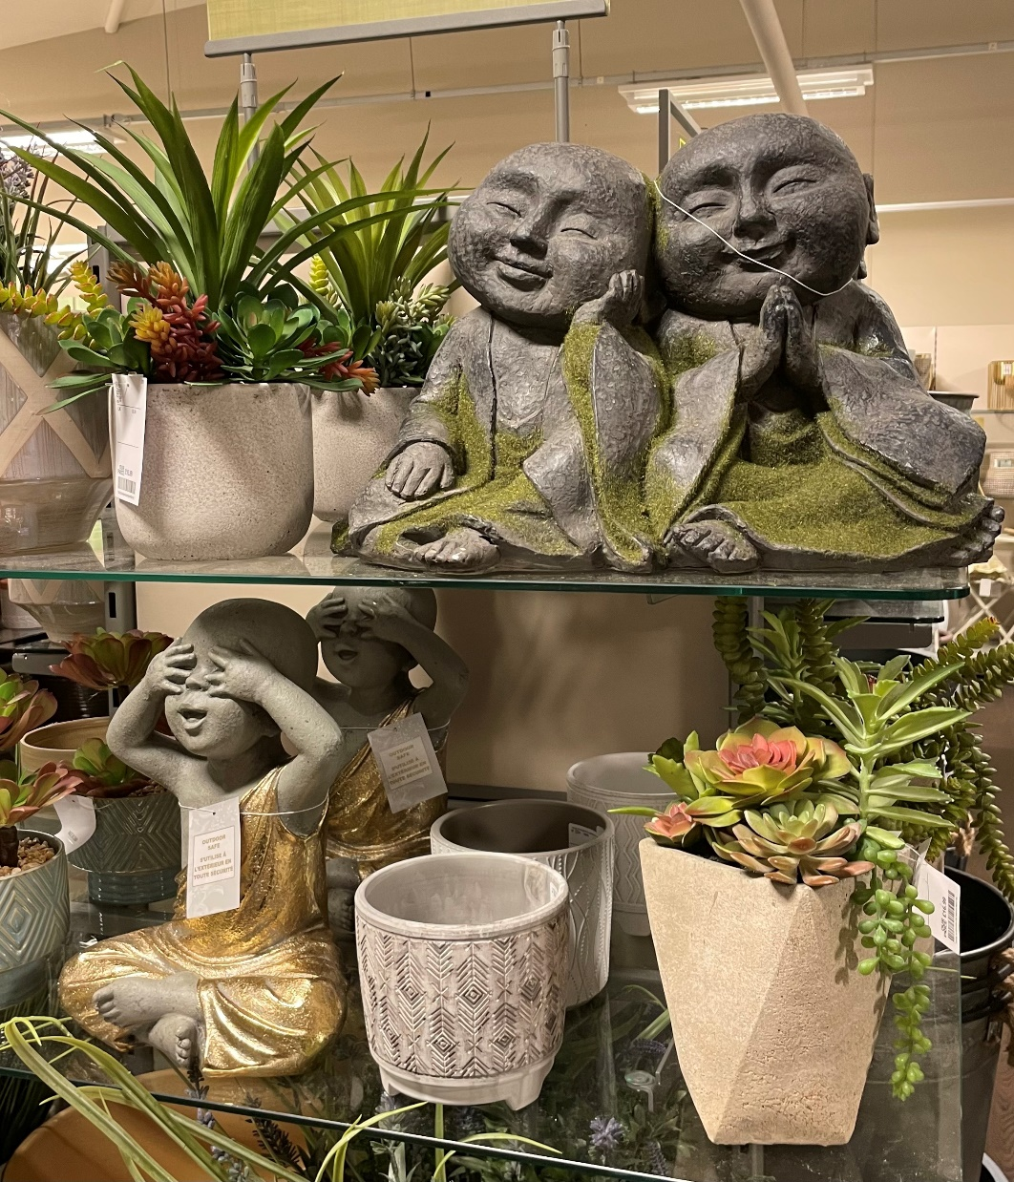
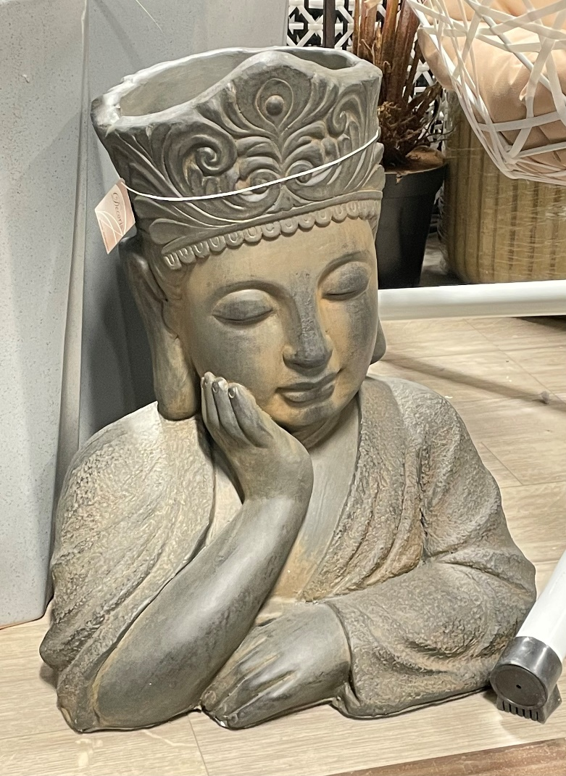
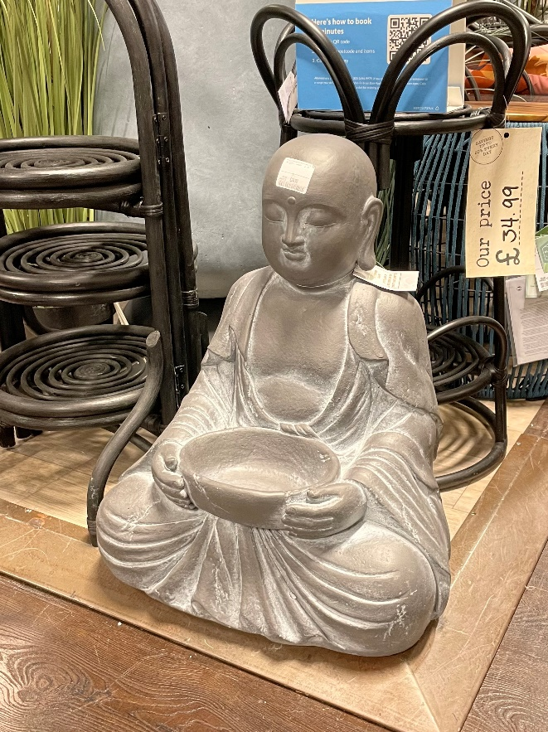
Commercialized
Buddhism
Notes:
All images, apart from the book (top right) were taken from the same branch of a well-known home goods retailer on a single visit. On the day when these photographs were taken, there were over 30 different Buddhist-inspired home or garden sculptures visible on the shelves.
A recent volume dealing with the commercialization of Buddhism (and other Asian religions) in the West is Sophia Rose Ariana’s Buying Buddha, Selling Rumi (2020, Oneworld), pictured on the slide.

Slide 4
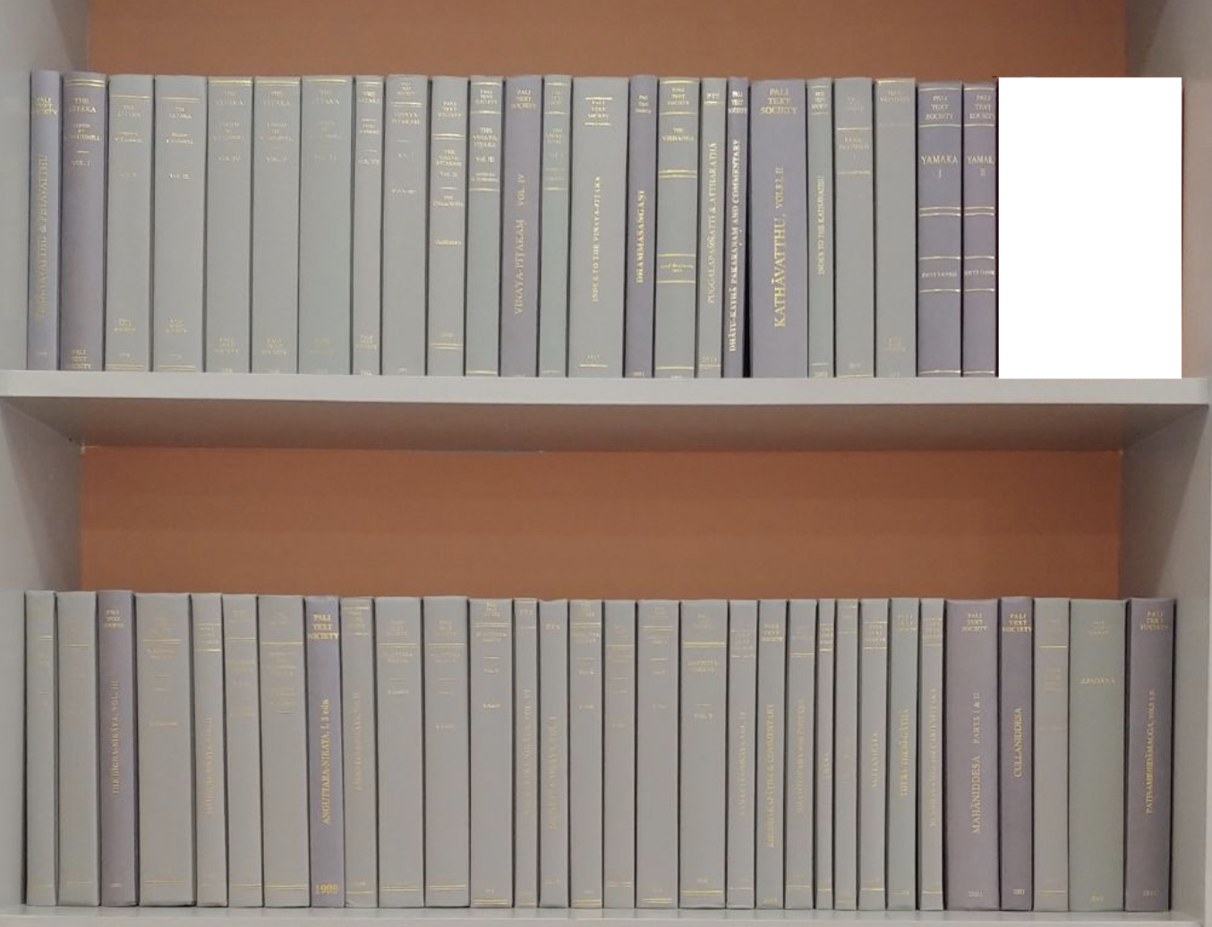
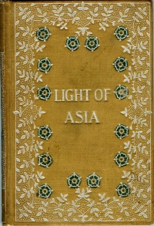
Various British Encounters with Buddhism (I)
“The Scripture of the Saviour of the World,
Lord Buddha – Prince Siddartha styled on earth,
In Earth and Heavens and Hells Incomparable,
All-honoured, Wisest, Best, most Pitiful;
The Teacher of Nirvana and the Law.
Then came he to be born again for men…”
From the introduction to Arnold’s The Light of Asia (1879).
Above: a complete collection of the Pali Text Society edition of the Pāli Canon, published 1877–1927, in 57 volumes.
Right: an American edition of Edwin Arnold’s 1879 The Light of Asia, a narrative poem about the Buddha.
Notes:
As well as its edition of the Pāli Canon (which is of course in the language Pāli), the Pali Text Society has also produced influential translations of its content. As we have noted throughout this series, many of these translations – and others besides, as well as supplementary essays – can be found online at the site www.accesstoinsight.org. We recommend the site (together with its search-bar!) as a good resource for materials pertaining to Theravāda Buddhism, and the content of the Pāli Canon in particular.
The Light of Asia can be found online at multiple sites, including here: https://www.gutenberg.org/files/8920/8920-h/8920-h.htm.
A very recent volume on The Light of Asia and its impact is Jairam Ramesh, The Light of Asia: the poem that defined the Buddha, (2021, Penguin).

Slide 5
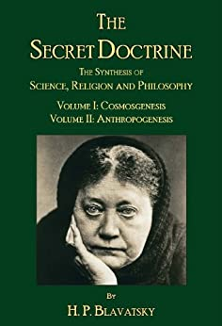
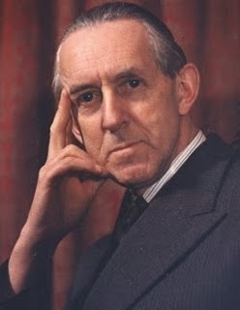
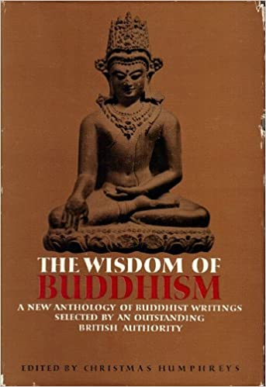

Various British Encounters with Buddhism (II)
Left: one of many publications by Helena Blavatsky, founder of the Theosophical Society.
Above: Christmas Humphreys (1901–1983), founder of the London Buddhist Society, and one of his publications.
Right: one of many works on contemporary ‘mindfulness’ on the market today, drawing no small amount of influence from Buddhism.
Notes:
There is today a vast market for books on Buddhism, between the poles of spiritualist readings in the vein of Blavatsky and the Theosophical Society, and then the appropriation of Buddhist ideas in the domain of mindfulness and psychiatry. Of the very many books available on the latter, The Mindful Way through Depression (which, as you can read on the slide, aligns itself with with ‘a proven program from leading scientists’) is produced by several leading authors and clinical psychologists in this tradition, including Mark Williams of the Oxford Centre for Mindfulness. One might look at its activities and consider how far these relate to Buddhism as described in these sessions, or otherwise in the classroom: https://www.oxfordmindfulness.org/.

Slide 6
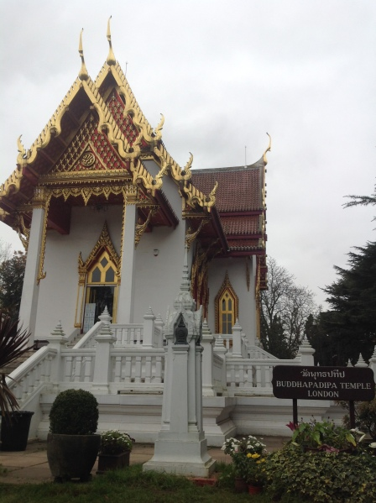
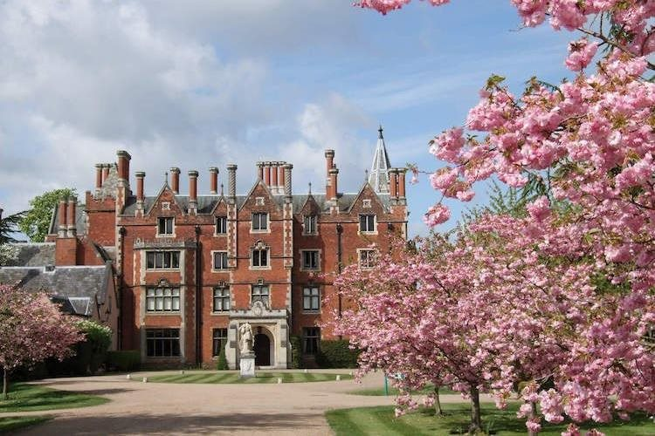
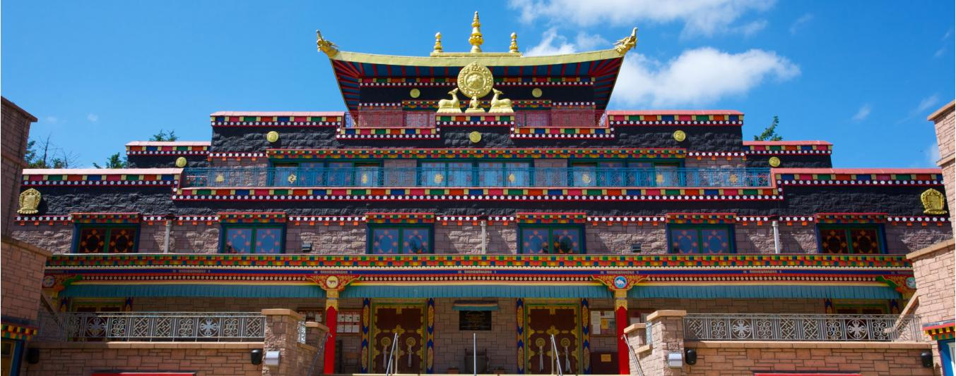
Global Buddhism comes to the UK
Left: Wat Buddhapadipa
Above: Taplow Court
Below: Kagyu Samye Ling
A potentially useful breakdown:
Theravada
East Asian Mahāyāna
Tibetan / Himalayan Mahāyāna
Western
Notes:
For the images and more information about each example see (left to right)
https://buildingbuddhism.wordpress.com/2014/12/16/wat-buddhapadipa-thai-buddhism-comes-to-wimbledon/
https://sgi-uk.org/Local-Community/SGI-Centres/Taplow-Court
https://www.samyeling.org/
You can find some interesting reflections on all the major Buddhist centres in England and Wales (sadly not Scotland) on the Building Buddhism project blog https://buildingbuddhism.wordpress.com.
For more on the Network of Buddhist Organisations see https://www.nbo.org.uk/

Slide 7
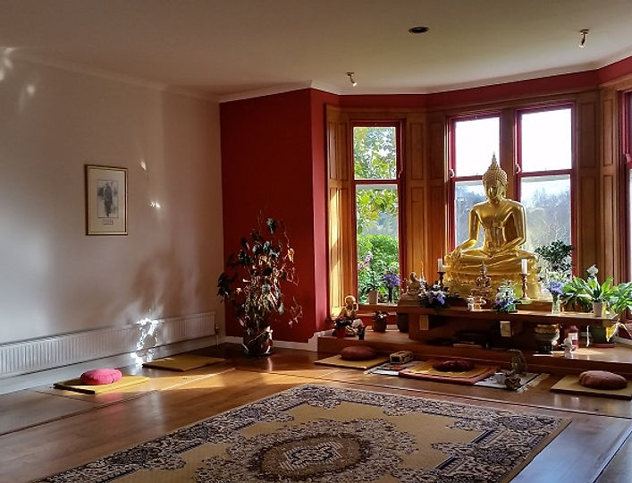
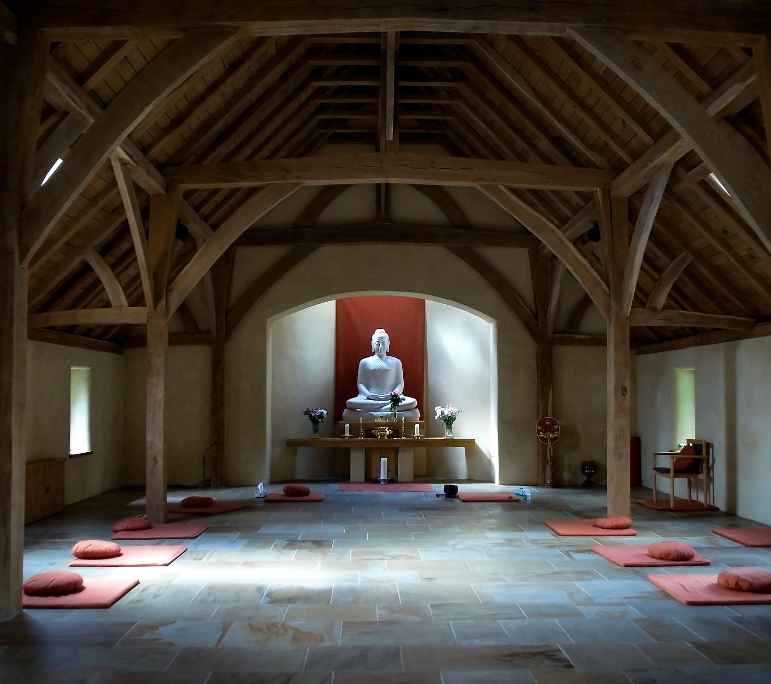
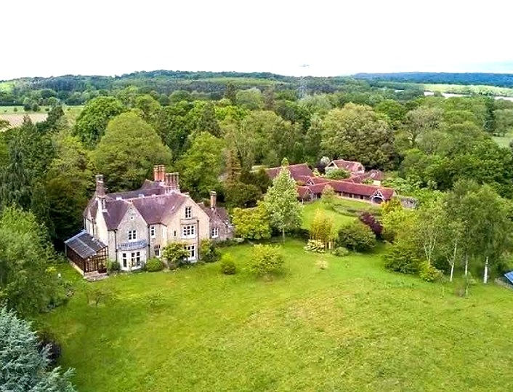
The Forest Sangha:
From Thailand to West Sussex
Cittaviveka / Chithurst Monastery. Photographs from www.cittaviveka.org
Notes:
For the Forest Sangha’s own account of the struggles over nuns’ ordination see https://forestsangha.org/community/news/where-we-are-now
For an interesting study of Amaravati see https://buildingbuddhism.wordpress.com/2014/02/18/352/

Slide 8
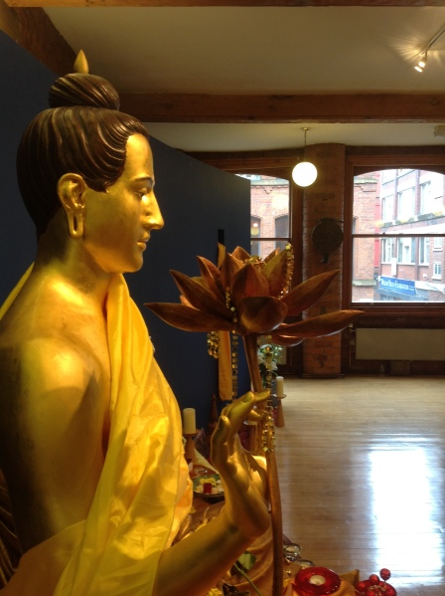
Western Buddhism: Triratna
“The Buddha is seen as a ‘Refuge’ not because he will help us to escape life and its difficulties, but because his example and teaching represent practical and reliable responses to our sorrows in the face of life. They can help free us from attachment to ‘false refuges’ — those mundane things we look to for happiness and security, but which are ultimately incapable of providing them. The Buddha’s vision and example are fundamental.”
Triratna explanation of the refuges: https://thebuddhistcentre.com/text/going-refuge
Left: The Manchester Buddhist Centre, one of the main Triratna centres in the UK
Notes:
You can learn more about Triratna’s vision of Buddhism and the Buddha on https://thebuddhistcentre.com/
For more on the Manchester Buddhist Centre see https://buildingbuddhism.wordpress.com/2014/12/27/340/

Slide 9
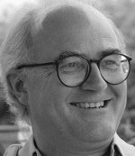
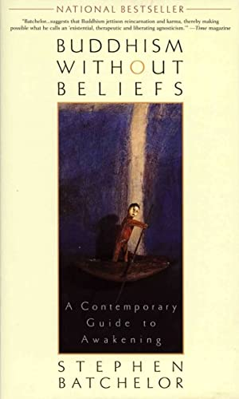
‘Secular Buddhism’
“The Buddha was not a mystic. His awakening was not a shattering insight into a transcendent Truth that revealed to him the mysteries of God. He did not claim to have had an experience that granted him privileged, esoteric knowledge of how the universe ticks. Only as Buddhism became more and more of a religion were such grandiose claims imputed to his awakening.
…
Historically, Buddhism has tended to lose its agnostic dimension through becoming institutionalized as a religion (i.e., a revealed belief system valid for all time, controlled by an elite body of priests).”
Stephen Batchelor, Buddhism without Beliefs. 1997.
New York: Riverhead, pp.5 and 16.
Notes:
Aside from Batchelor’s works (which are many: see https://www.stephenbatchelor.org/index.php/en/), good volume dealing with modern forms of Buddhism, and ‘Buddhist modernism’ (slightly different!) include Charles Prebish and Martin Baumann, Westward Dharma (2002, Uni of California Press), Steven Heine and Charles Prebish, Buddhism in the Modern World (2003, OUP), and David McMahan, The Making of Buddhist Modernism (2009, OUP). A further good volume regarding Britain in particular is Robert Bluck, British Buddhism (2006, Routledge).

Slide 10
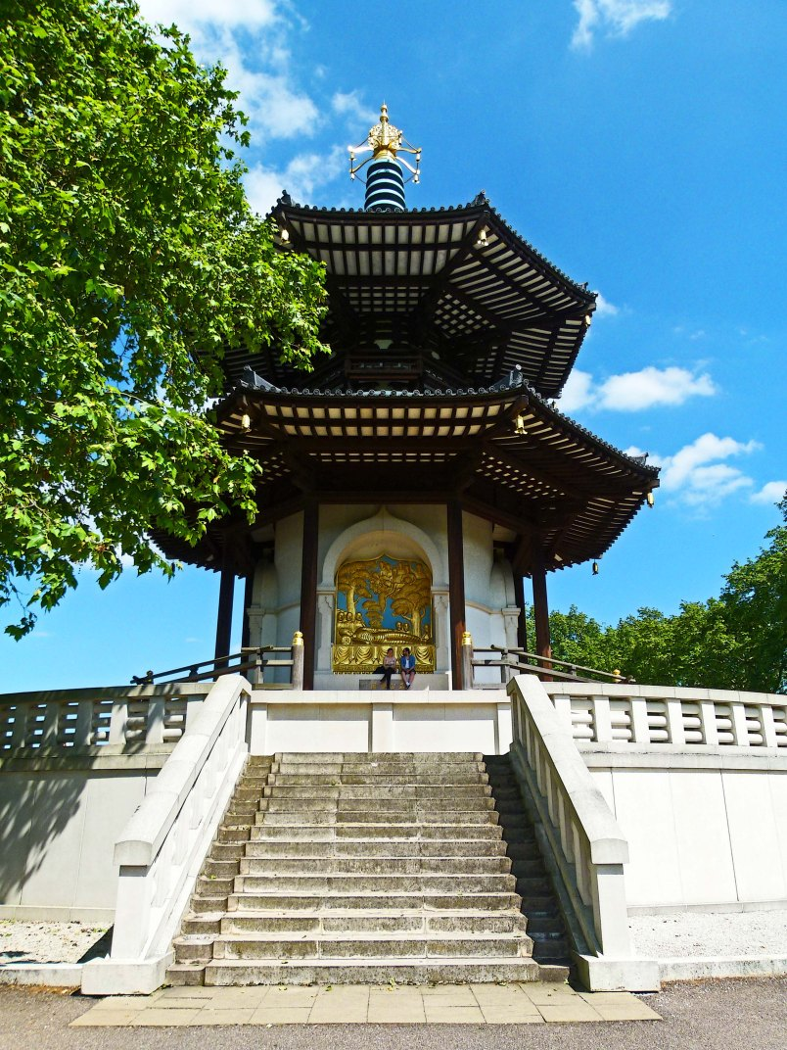
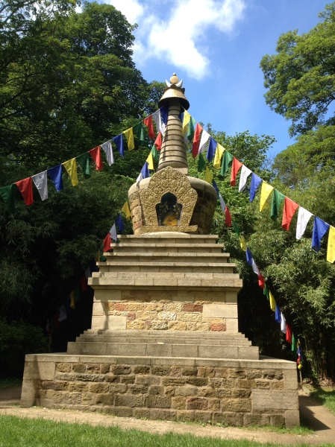
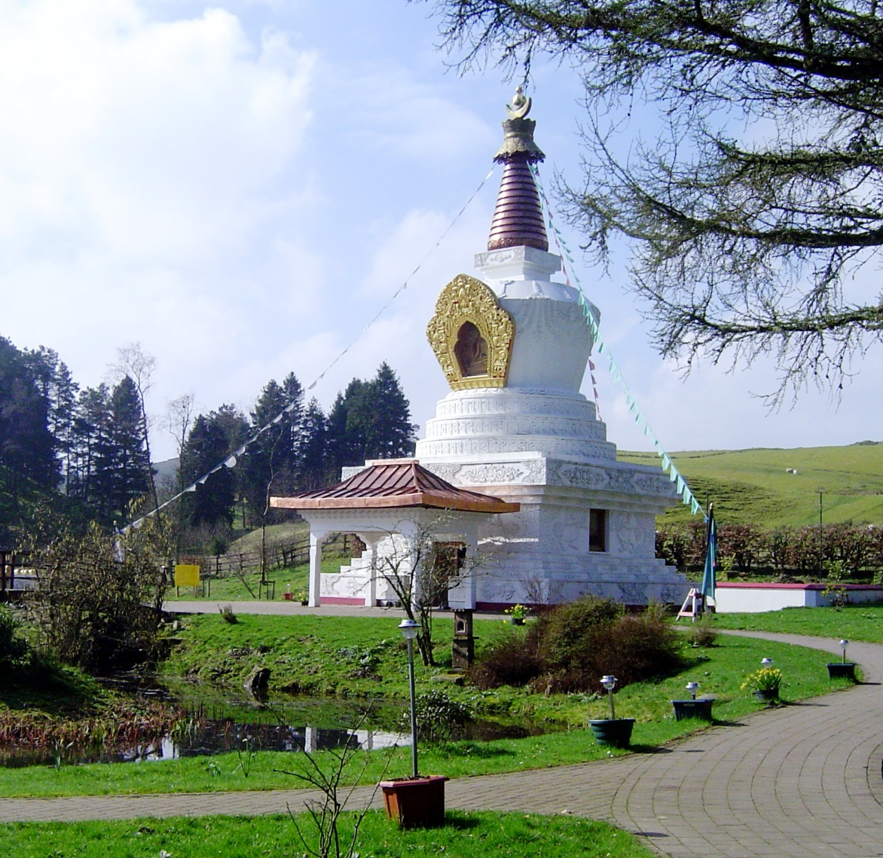
Stūpas and Pagodas
Left: Kagyu Samye Ling Stupa
Middle: Harewood House Stupa
Right: Battersea Peace Pagoda
Samye Ling
Notes:
Left: https://commons.wikimedia.org/wiki/File:Samye_Ling_Stupa.JPG
Photograph by Robert Matthews 2005, CC-BY-SA3.0
For more information see https://www.samyeling.org/about/the-samye-ling-victory-stupa-for-world-peace/
Middle: https://buildingbuddhism.wordpress.com/2015/05/04/the-stupa-at-harewood-house-a-yorkshire-bhutan-co-production/
You can hear the Earl of Harewood talk about the stupa here https://www.thebuddhistsociety.org/page/founders-day-2021
Right: Battersea Park Peace Pagoda is part of a series built by Nichidatsu Fujii and the group that he founded (Nipponzan-Myohoji) which is an offshoot of Nichiren Buddhism.

Slide 11
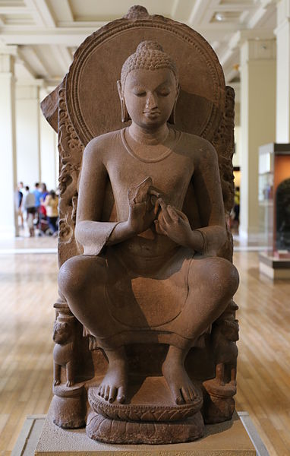
Conclusion
The full range of Buddhism’s diversity across Asia, and so also the range of ways in which the Buddha is remembered and revered, are today well represented across Britain. Added to these are still newer ways of thinking about the Buddha that can be found in bookshops, popular culture, museums and, importantly, at Buddhist centres and monuments, where Buddhists from Asia and the West maintain some or other conceptualization of the Buddha’s continuing influence in and importance to the world.
Notes:
The image is of a (likely) fifth century Buddha from Sarnath (the supposed site of the Buddha’s first teaching), currently held at the British Museum (https://commons.wikimedia.org/wiki/File:British_Museum_-_Seated_Buddha_(Gupta_period).JPG). Many museums in the UK (not only the British Museum!) have well-curated collections of Buddhist images and other artefacts, and with a little research could prove to be accessible and informative places for school visits.

