Slide 1
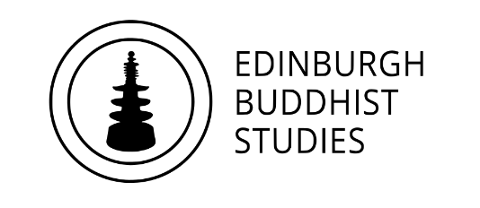
Who is the Buddha?
Dr Naomi Appleton
University of Edinburgh, naomi.appleton@ed.ac.uk
Dr Chris Jones
University of Cambridge, cvj20@cam.ac.uk

Slide 2
Series aims
To explore different characterizations of the Buddha in Asian Buddhist literature and practice, and in the Western academic and popular imagination.
To discuss and clarify concepts in Buddhism that appear in secondary education curricula across the UK (e.g., GCSE, A-Level, Scottish N5s and Highers).
To introduce some potentially useful sources for understanding the Buddha and these
concepts (e.g., illuminating passages from the Pāli Canon).
Method
We will consider ideas proper to forms of Theravāda and Mahāyāna Buddhism. When discussing the former, we use terminology in Pāli (e.g., kamma, dhamma), when discussing the latter, we use terminology in Sanskrit (e.g., karma, dharma).
Slides will be made available online, and contain notes that elaborate further on their content.
Image Copyright Ashmolean Museum, Oxford
Notes:
Slides in this series will be accompanied by notes providing further details about sources or images that we use.
We invite you to ask further questions about any of these during our meetings, and are happy to respond to any other questions by email (naomi.appleton@ed.ac.uk; cvj20@cam.ac.uk).

Slide 3
Programme
January 27th The Buddha: Historical Figure or Literary Character?
February 3rd The Buddha as Philosopher
February 17th The Buddha as Social Reformer
February 24th The Buddha in Buddhist Practice
March 10th The Buddha among Buddhas
March 17th The Buddha in Modern Britain
Each session will consist of roughly 45 minutes of presentation, and up to 30 minutes of questions and/or discussion.
The presentations (though not the discussions) will be recorded. Please keep cameras off during this part of the event.
Image Copyright British Museum, London
Notes:
The image depicts a stone relief panel from Gandhāra, modern-day Pakistan/Afghanistan, dated to the 1-2nd century CE (https://www.bmimages.com/preview.asp?image=01613030008&itemw=4&itemf=0001&itemstep=1&itemx=15).
Gandhāra was the western-most region of the ancient and classical Buddhist cultural sphere, and remained so until the arrival of Islam in the eighth century. In this panel, the central figure is not the Buddha who is central to this series of presentations (i.e., it is not Siddhattha Gotama, aka Śākyamuni), but in fact is another Buddha, called Dīpaṃkara, whom Buddhist tradition situates in the far distant past, and is considered to have been the first teacher of the person who would eventually go on to become the Buddha of our age. We will return to this in the fifth session.

Slide 4
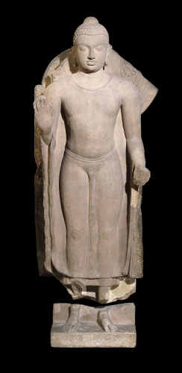
Buddha ‘awakened one’
Before his awakening: Bodhisattva [Sanskrit] or Bodhisatta [Pāli] – ‘being on the way to awakening’
Some other names/epithets:
Siddhārtha Gautama [Sanskrit] / Siddhattha Gotama [Pali]
Śākyamuni [Sanskrit] – ‘Sage of the Śākya clan’
Tathāgata [P. and Skt] – ‘one who has gone thus’
Bhagavan [P. and Skt] – ‘Exalted One’ or ‘Lord’
Possibly lived during the fifth century BCE (ca. 480–400 BCE), although traditional accounts tend to put this a century or more earlier.
Image Copyright British Museum
Notes:
The term ‘Buddha’ means, very literally, ‘awakened’. Although it is widely accepted that Buddhism has to do with ‘enlightenment’, this specific choice of language is a result of early European study of Buddhism in the nineteenth century, which conceptualized the Buddha as a figure comparable to Western ‘enlightened’ religious teachers, theologians or philosophers.
The Buddha depicted in this slide is again from Gandhāra (see note on the previous slide), and the early centuries of the Common Era. Buddha images wherever they are found bear a series of physical ’marks’ or attributes that Buddhist tradition associates with the bodies of Buddhas, which mark them out as having performed a superlative amount of good activity (karma) over the many lives leading up to their awakening. These marks (traditionally 32 in total) include a protuberance on the top of the head, webbed-fingers and a curl of hair in the centre of the forehead (https://en.wikipedia.org/wiki/Physical_characteristics_of_the_Buddha). The origins and individual significance of these marks are unknown to us.

Slide 5
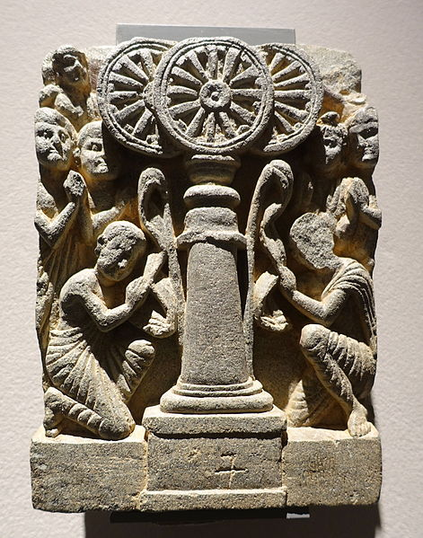
The Three Jewels or Three Refuges
Buddha – the awakened one who realises and shares the dharma/dhamma
Dharma [Skt] / Dhamma [P.] – the truth that is the substance of Buddhist teaching
Saṅgha – the community of Buddhist practitioners
Image Copyright Ethnologisches Museum, Berlin
Notes:
You can find a useful video showing how Buddhists take the three refuges (and five precepts) here: https://youtu.be/_o9ScjUn2Ec and here are some longer chants in praise of the three jewels/refuges, as used at a memorial day for Ajahn Chah, a famous monk in the Thai forest tradition of Theravāda Buddhism: https://youtu.be/JFcKKBcAE80. Both videos have English subtitles so you can easily follow what is going on.
The image on the left is again from Gandhāra (see notes to the previous slide), and again the earliest centuries of the Common Era (https://commons.wikimedia.org/wiki/File:Veneration_of_the_Three_Jewels,_Chorasan,_Gandhara,_2nd_century_AD,_schist_-_Ethnological_Museum,_Berlin_-_DSC01642.JPG).
Monks are depicted showing reverence to three wheels (cakkas; Sanskrit equivalent cakra), which symbolize the three jewels. The wheel was a symbol of authority in ancient India, as reflected in the motif of the Buddha’s ‘dhammacakka’ (see later slide), but also in imperial artwork associated with the Emperor Aśoka (reign c. 268-232 BCE); the wheel found in inscriptions attributed to Aśoka today features at the centre of the Indian national flag.
The image on the right is a modern depiction of the three jewels, which adorn any number of Buddhist buildings and publications across the world.

Slide 6
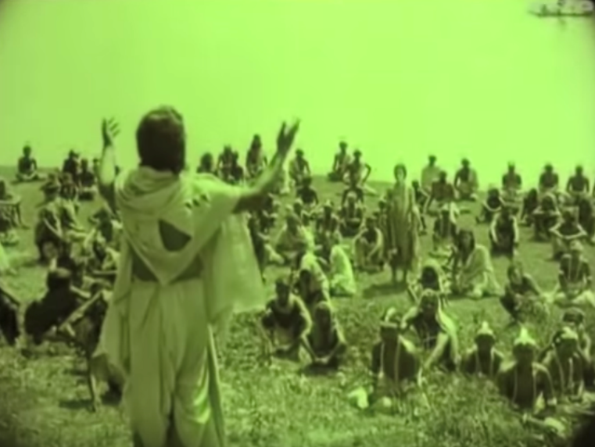
The Buddha as a historical figure?
‘So what do we actually know about the [historical] Buddha? It is fair to say that he was born, he lived, and he died. The rest remains lost in the mists of myth and legend…’
Bernard Faure, 2009. Unmasking Buddhism, p.12.
Our sources for the life-story:
Texts, art, pilgrimage sites
Literature, hagiography or biography?
Above: still from The Light of Asia (1925), the film based on Edwin Arnold’s 1879 poem of the same name, depicting the Buddha preaching.
Notes:
The quotation is from Faure (2009), Unmasking Buddhism (https://www.amazon.co.uk/Unmasking-Buddhism-Bernard-Faure/dp/1405180641).
Arnold’s The Light of Asia, as well as the film adaptation of it, are excellent examples of the Western imagination grappling with the figure of the Buddha, in which he is seen very much through a Christian lens. Very good discussions of this phenomenon are by Donald Lopez Jnr., for example his Curators of the Buddha (1995), and From Stone to Flesh: A Short History of the Buddha (2013).
Although the position is unpopular, there nonetheless have been some significant scholars of Buddhism in the last two hundred years who believe that any hunt for a historical person behind the vast, mythological literature concerned with the Buddha is not simply very difficult, but wrong-headed – that is to say, there was no historical Buddha. That this position has even any appeal tells us something about the kinds of materials with which we work when looking at the life of the Buddha.

Slide 7
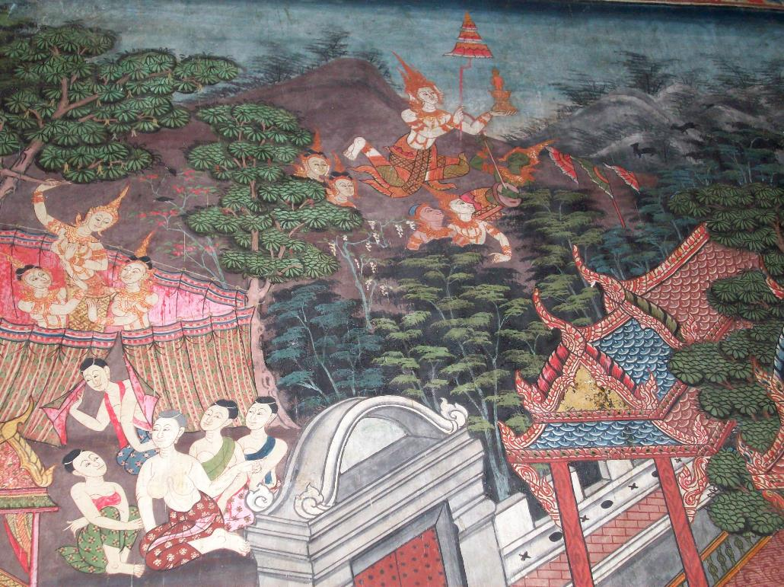
The Buddha’s birth: an example
Pilgrimage site: Lumbinī
Miracles
Gods
Purity
Back-story
Communal story
Birth as cosmic event
Temple mural of Buddha’s birth: Wat Pratu San, Suphanburi, Thailand
Notes:
The image is a photograph by Naomi Appleton. Please feel free to use for educational purposes. You can tell that the flying god is Brahmā (who is known also in traditions of Hinduism) because he has four faces (though only three are visible here).
For a summary account of the Buddha’s birth, amongst a very accessible and insightful account of other aspects of his lifestory, see John S. Strong, The Buddha: A Beginner’s Guide (Oneworld, 2009, previously published as The Buddha: A Short Biography in 2001).
John Strong’s excellent textbook Buddhisms: An Introduction (Oneworld, 2015) has an opening vignette that explores Lumbinī, site of the Buddha’s birth, as a way into the different varieties of Buddhism in the world today, since each branch has its own temple or monastery at the great pilgrimage site.
On the experiences of the fetus see Vanessa Sasson, ‘A Womb with a View: The Buddha’s Final Fetal Experiences’ in Jane Marie Law and Vanessa Sasson eds, Imagining the Fetus: The Unborn in Myth, Religion and Culture (OUP, 2008).
For more on the creative opportunities of the story see Jonathan Silk, ‘The Fruits of Paradox: On the Religious Architecture of the Buddha’s Life Story’ Journal of the American Academy of Religion 71/4 (2003): 863-881.

Slide 8
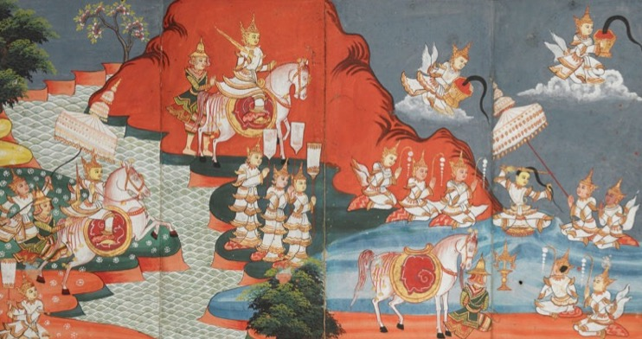
The Buddha as royalty
Then, from Chāndaka’s hand the resolute prince
Took the sword with the hilt inlaid with gems;
He then drew out the sword from its scabbard,
With its blade streaked with gold,
Like a snake from its hole.
Unsheathing the sword, dark as a lotus petal,
He cut his ornate head-dress along with the hair,
And threw it in the air, the cloth trailing behind –
It seemed he was throwing a swan into a lake.
As it was thrown up, heavenly beings caught it
Out of reverence so they may worship it;
Throngs of gods in heaven paid it homage
With divine honors according to rule.
Verses from the Buddhacarita, vv.6.56–58.
Image copyright British Library.
Notes:
The Buddhacarita is probably our oldest complete account of the Buddha’s life – but it is hardly what we might call a ‘biography’. The Buddhacarita (‘Career of the Buddha’) is a work of epic poetry, composed in probably the C2nd CE by a figure called Aśvaghoṣa – well over 500 years after we supposed the historical Buddha to have lived and died. It is an early source for Siddhārtha Gautama imagined very clearly and consistently as a ‘prince’, raised in a ‘palace’, which is undoubtedly how he was remembered later in India and across Asia.
A celebrated English translation of the Buddhacarita (or most of it – not all of the text survives in its original Sanskrit!) is by E.H. Johnston, Aśvaghoṣa’s Buddhacarita, or Acts of the Buddha, although others are available.
This mention of the Buddha’s hair as an object of reverence invites a topic to which we will return in a later session: devotion to the Buddha’s relics, which has been central to Buddhism since its very early life in India.

Slide 9
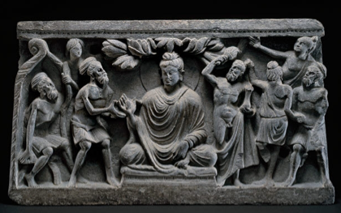
The Buddha as more-than-human
A passage from the Doṇa Sutta (of the Pāli Canon)
[The Buddha is approached by a religious mendicant, named Doṇa (whom the Buddha respectfully addresses as ‘brahmin’), who asks the Buddha what the Buddha will be in his next existence…]
Will you be a deity?
(the Buddha says:) No, brahmin, I will not.
Will you be a ‘celestial spirit’?
…No, brahmin, I will not.
Will you be a ‘worldly spirit’?
…No, brahmin, I will not.
Will you be a human being?
…No, brahmin, I will not.
…
[The Buddha eventually concludes…]
The [mental] contaminations by which I would go to the state of a deity, or celestial spirit in the sky, or to the state of a worldly spirit or human – those have I destroyed, ruined, removed their roots. Like a lotus, rising up, untainted by water, untainted by the world; I, brahmin, am awoken (Buddha).
Image Copyright British Museum
Notes:
For a full translation of the Doṇa Sutta see https://www.accesstoinsight.org/tipitaka/an/an04/an04.036.than.html.
This is just one of the many hundreds of ‘discourses’ (suttas; Sanskrit sūtras), supposed to preserve things taught by the Buddha, that survive in the Pāli Canon – the authoritative literature of the Theravāda Buddhist tradition. Many more discourses, of varying length, are considered authoritative by Mahāyāna Buddhists.
Note a complication with the translation (a good example of how the interpretation of Buddhist literature is still very much open to debate!): in the slide, questions asked to the Buddha are in the future tense, which is a literal reading of the Pali and seems to refer to what the Buddha will be in a next life; in the translation online (see link above in this note), the questions are in the present tense, following scholars who argue that use of the future tense in the Pali text is used to convey perplexity or surprise. Arguments can be made for either case!
The image is yet again from Gandhāra (see previous slides), and the 2-3rd century CE. It may well not depict the specific discourse (sutta/sūtra) discussed here, but it certainly features the Buddha interacting with an ascetic with long, matted hair, who may be what we call a brahmin (in brief: someone committed to the performance of rituals). On the other side of the Buddha is depicted a burly figure called Vajrapāṇi, who is a ‘worldly spirit’ (yakkha; Sanskrit equivalent yakṣa) such as those mentioned in the translation, who was often depicted accompanying the Buddha as a protector. Notice that here this spirit looks conspicuously ’Herculean’; Gandhāra was between the Indian and Greek cultural spheres, and its art exhibits influence by both worlds.

Slide 10
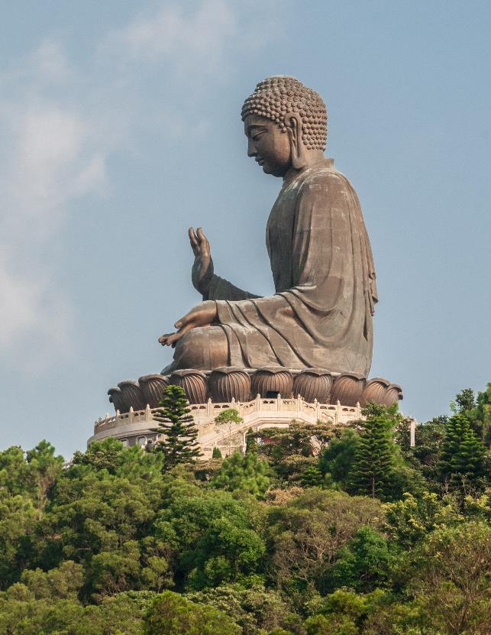
The Buddha as transcendent being
[People in the world say that] the Lord Śākyamuni, after going forth from his home among the Śākyas, arrived at unsurpassed, supreme awakening, on the summit of the terrace of awakening at the town of Gayā. However, sons and daughters of good families, the truth is that many hundreds of thousands of myriads of crores of aeons ago [i.e. a very, very long time ago], I arrived at unsurpassed, supreme awakening…
From the fifteenth chapter of the Lotus Sūtra (Saddharmapuṇḍarīka), a Mahāyāna Sūtra.
Right: a giant Śākyamuni Buddha, ‘the Tiantan Buddha’, Hong Kong. Completed 1993.
Notes:
The Lotus Sūtra, from which this passage is drawn, is a literary work perhaps completed in the second century CE. It is a Mahāyāna discourse (sūtra) – so attributed to the Buddha, but likely composed several centuries after the life of any historical founder of Buddhism. Although not the most influential Buddhist text in India, the Lotus undoubtedly went on to become one of the touchstones of East Asian Buddhism.
An English translation of the most celebrated version of the Lotus Sūtra, in Chinese, can be downloaded from the Bukkyō Dendō Kyōkai (who make available other good translations of many Buddhist texts), here: https://bdkamerica.org/product/the-lotus-sutra-revised-second-edition/.
An excellent recent guide to the Lotus Sūtra – just recently available in paperback – is Lopez & Stone, Two Buddhas Seated Side by Side: A Guide to the Lotus Sūtra (2019, Princeton University Press).
The Tiantan Buddha depicted in the slide is just one of a great number of gigantic Buddha-images that have been constructed in East Asia, where the Buddha is generally conceived as a cosmic being who continues to influence our world and others besides, the existence of which are explored in a great many Mahāyāna Buddhist texts.

Slide 11
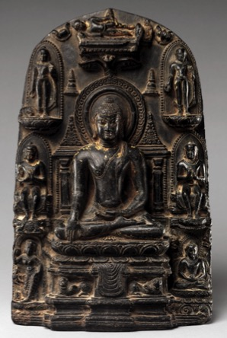
Conclusion
The Buddha is of central importance to Buddhists everywhere, but his historical life is neither well-evidenced nor, necessarily, important to uncover. What matters is the many stories of his life and activities preserved by different Buddhist communities and the ways in which these underpin Buddhist practices and beliefs.
Left: 10th century stele from Bihar (North India), depicting the eight great events in the Buddha’s life-story, each associated with a pilgrimage site. Metropolitan Museum of Art: image in the public domain
Notes:
For more on the image see https://www.metmuseum.org/art/collection/search/38615
The central image shows the Buddha’s achievement of awakening, while events around the edges are (clockwise from bottom left) his birth, first sermon, subduing of a maddened elephant, death/final nirvāṇa, descent from a spell teaching in heaven, performance of miracles, and receipt of a gift from a monkey. Each event is associated with a pilgrimage site.

