Slide 1
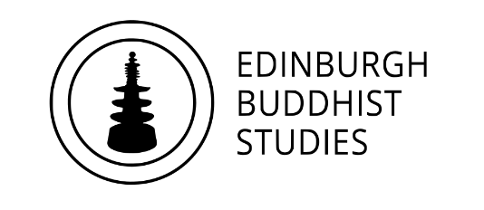
Who is the Buddha?
Dr Naomi Appleton
University of Edinburgh, naomi.appleton@ed.ac.uk
Dr Chris Jones
University of Cambridge, cvj20@cam.ac.uk

Slide 2
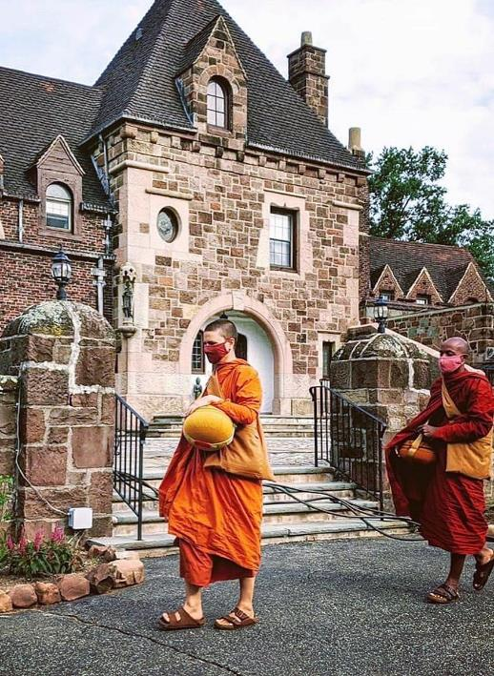
Programme
January 27th The Buddha: Historical Figure or Literary Character?
February 3rd The Buddha as Philosopher
February 17th The Buddha as Social Reformer
February 24th The Buddha in Buddhist Practice
March 10th The Buddha among Buddhas
March 17th The Buddha in Modern Britain
Each session will consist of roughly 45 minutes of presentation, and up to 30 minutes of questions and/or discussion.
The presentations (though not the discussions) will be recorded. Please keep cameras off during this part of the event.
Buddhist monastics on almsround, Empty Cloud monastery, USA
Notes:
The image depicts Buddhist monastics from the Empty Cloud monastery in New Jersey, USA setting off on an alms-round. Photo Wikimedia commons, uploaded by Rikku411, CC-BY-SA4.0. This is a routine engagement between monastics (who have, amongst other things, given up earning a living) and lay supporters, who place food in the bowls, and it takes place to this day across all Theravada Buddhist countries. On the one hand, this signifies the importance of monastic disengagement from the world, but on the other hand shows that complete withdrawal is neither possible nor desirable.

Slide 3
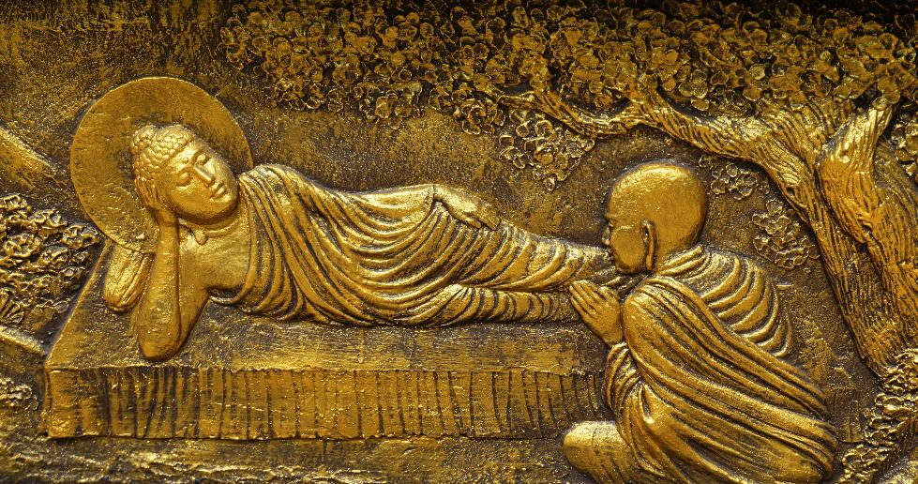
The Five Precepts (pañcasīlāni)
To refrain from destroying living beings
To refrain from taking that which is not given
To refrain from sexual misconduct
To refrain from incorrect speech
To refrain from intoxicating substances
Buddha and Ānanda in conversation. Maha Vihara Mojopahit, Trowulan, East Java. Photo by Anandajoti Bhikkhu CC-BY-2.0
Notes:
For the full text of the five precepts, and links to discussions of expanded lists of eight and ten, see https://www.accesstoinsight.org/ptf/dhamma/sila/pancasila.html
For one of the texts that has the Buddha talk about the benefits of friendship see https://www.accesstoinsight.org/tipitaka/sn/sn45/sn45.002.than.html
Image: Ānanda at the feet of the Buddha. Maha Vihara Mojopahit, Trowulan, East Java. Photo by Anandajoti Bhikkhu CC-BY-2.0 https://commons.wikimedia.org/wiki/File:040_Ananda_worships_Buddha_(25595318747).jpg
Ānanda was the Buddha’s cousin and, after becoming a monk, he was the Buddha’s personal attendant and loyal companion for many years. He is credited with encouraging the Buddha to allow women to ordain, and is traditionally believed to have memorized all the Buddha’s teachings preserved in the sutta texts. In the early Buddhist literature he is sometimes portrayed as being a bit foolish, but good-hearted.

Slide 4
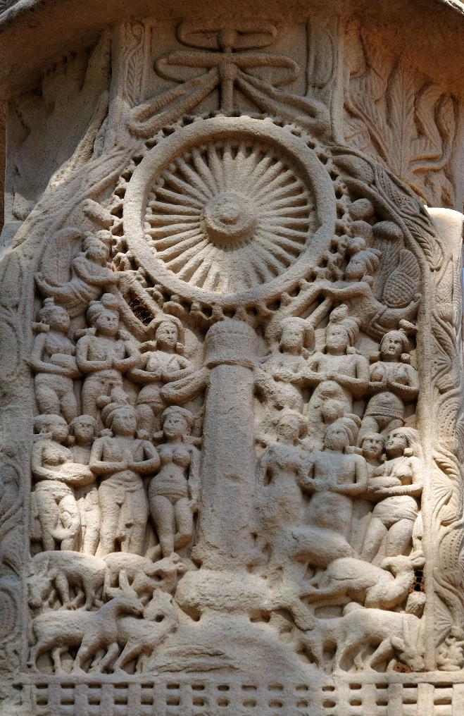
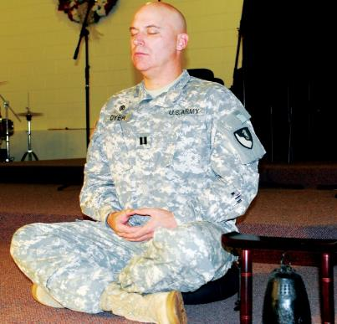
Does engaging in the world necessarily involve compromising on Buddhist ideals?
Buddha’s teachings on sacrifice
Kingship = inevitable violence?
Soldiers and practical mitigations
Far left: Ashoka visits the site of the Buddha’s first sermon, as depicted on the stupa at Sanchi.
Centre: The first Buddhist chaplain to the US military, who was appointed in 2011.
Notes:
For the story of the goat that is a rebirth of a priest who sacrificed goats see https://blogs.ed.ac.uk/teachingbuddhism/2020/06/03/the-goat-who-laughs-and-weeps/
We spoke about the Buddha’s assent to the request he stop ordaining soldiers in an earlier webinar:
https://blogs.ed.ac.uk/teachingbuddhism/2021/05/12/introduction-to-key-concepts-4-eightfold-path-and-five-precepts/
For a sutta text in which the Buddha tells a soldier (reluctantly) that dying in battle is not going to lead to heaven see https://www.accesstoinsight.org/tipitaka/sn/sn42/sn42.003.than.html
Images:
The first Buddhist chaplain to the US military: https://www.army.mil/article/70976/armys_first_buddhist_chaplain_serving_11th_engineer_bn
Ashoka visits the deer park, site of the Buddha’s first sermon, as depicted on the stupa gateway at Sanchi, Madhya Pradesh. Photo by Bishwarup Ganguly CC-BY3.0 https://commons.wikimedia.org/wiki/File:Emperor_Ashoka_and_his_Queen_at_the_Deer_Park.jpg
The wheel symbolizes the sermon – known as the first turning of the wheel of the dharma. Ashoka is credited with building many stupas (reliquaries that functioned as pilgrimage sites) including that at Sanchi.

Slide 5
Naturalizing social hierarchy in ancient and classical Hinduism (not Buddhist…)
Brahman/
Brahmin
(‘priest’)
kṣatriya
(‘noble’)
vaiśya
(‘merchant’)
śūdra
(‘worker’)
‘untouchable’
The duties of brahmins, nobles, merchants and workers…are distributed according to qualities that come from their own nature.
Tranquility, restraint, austerity, purity, patience, honesty, knowledge, discernment and conviction are the duties of brahmins, born of their own nature.
Valour, majesty, courage, skill, bravery, generosity and sovereignty are the duties of nobles (Sanskrit kṣatriyas), born of their own nature.
Plowing, herding and trade are the duties of merchants (Sanskrit vaiśyas), born of their own nature, while service [to others] is the duty of workers (Sanskrit śūdras), born of theirs.
Verses 18.41–44 of the Hindu Bhagavadgītā, echoing ideas that date back to before the beginnings of Buddhism in India
Notes:
Obviously enough the Bhagavadgītā is not a Buddhist text – rather, it is a cornerstone of much modern Hinduism, and was undoubtedly composed later than our earliest Buddhist materials, and likely in the early centuries CE. Many, many translations of it are available online and in print.
The model of social order presented in sources like the Bhagavadgītā is something against which Buddhist authors pushed against for centuries, but it is important to appreciate that 1) this model was likely not widely accepted when we suppose the Buddha to have lived (ca. C5th BCE), and 2) it was always a model proposed and advanced by Brahmins – it is normative rather than descriptive. Different traditions of modern Hinduism continue to wrestle with difficult statements in their sacred literature concerning not only social discrimination based on family, but also the status of women apart from or often ‘beneath’ the fourth of these four kinds of status (varṇas – see next slide) described here.

Slide 6
From the Assalāyana-Sutta
‘Suppose a brahmin were to abstain from killing living beings, from taking what is not given, from misconduct in sensual pleasures, from false speech, from malicious speech, from harsh speech, and from gossip, were to be uncovetous, to have a mind without ill will, and to hold the right view. Upon the dissolution of the body, at death, would he alone go to a happy destination, even to a heavenly world, but not a noble, a merchant, or a worker?
No, master Gotama [i.e., the Buddha] – whether it be a noble, or a brahmin, or a merchant, or a worker – those of all four classes of person who abstain from killing living beings [etcetera]…at death, appear in a happy destination, even in a heavenly world.
Then by virtue of what, or with the support of what, do brahmins say: ‘brahmins are the highest class of person, those of any other class are inferior…?’
varṇa – lit. ‘colour’: a term used in ancient and classical India to distinguish four broad classes of persons in society (here ‘brahmins’; ‘nobles’; ‘merchants’; ‘workers’).
jāti – lit. ‘birth’: a related concept more prevalent in modern India, often translated as ‘caste’.
Notes:
For a full translation of the text (not word-for-word what is presented here), see: https://www.accesstoinsight.org/tipitaka/mn/mn.093.than.html
See the previous slide for the model of social order to which this passage objects.
When talking about modern India, it is important not to confuse the ancient and classical idea of varṇas (brahman; kṣatriya; vaiśya; śūdra) with the related but infinitely more complex notion of jāti, which is still prevalent in Indian society and sorts families into broad classes of birth.
The modern Indian constitution forbids discrimination based on birth or ‘caste’ (jāti), but its shadow still looms over how many communities live. There is a long tradition of Buddhism opposing these distinctions, though it is also obvious that a great many Buddhist authors accepted the everyday distinction between people of different heritage.

Slide 7
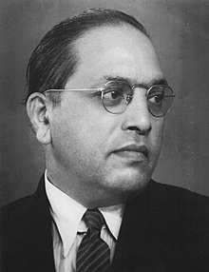
Ambedkar Buddhism of modern India (I)
‘If there is anything which could be said with confidence it is this: He (the Buddha) was nothing if not rational, if not logical. Anything therefore which is rational and logical, and other things being equal, may be taken to be the word of the Buddha.
The second thing is that the Buddha never cared to enter into a discussion which was not profitable for man’s welfare. Therefore anything attributed to the Buddha which did not relate to man’s welfare cannot be accepted to be the word of the Buddha.’
Ambedkar’s The Buddha and His Dhamma, p.350–351
B.R. Ambedkar (1891–1956), founder of ‘Ambedkar’ or ‘Navayāna’ Buddhism in India
Notes:
B.R. Ambedkar was a hugely influential figure in the birth of modern India, being the primary author of its constitution in the late 1940s. His late-life conversion to Buddhism was a very public protest at what he took to be the social discrimination intrinsic to, and advanced by, Hinduism. Ambedkar was very well-read, but his approach to the Buddha and early Buddhist literature is telling and very much of its time: we read here in the slide how Ambedkar accepted the C19-20th characterization of the Buddha as foremost a philosopher – regarding which see the previous session – although Ambedkar is perhaps unique for having held the Buddha to be something like the world’s first true political philosopher.
Another interesting interpretation of the Buddha’s teaching by Ambedkar, again from The Buddha and His Dhamma, follows below:
‘The doctrine of past karma is a purely Brahminic doctrine. Past karma taking effect in present life is quite consistent with the Brahminic doctrine of soul [ātman – see second session], the effect of karma on soul. But it is quite inconsistent with the Buddhist doctrine of non-soul [anātman – again, see second session for more]. It has been bodily introduced into Buddhism by some who wanted to make Buddhism akin to Hinduism or who did not know what the Buddhist doctrine was…The basis of the Hindu doctrine of past karma as the regulator of future life is an iniquitous doctrine. What could have been the purpose of inventing such a doctrine? The only purpose one can think of is to enable the state or society to escape responsibility for the condition of the poor and the lowly.’ (pp.343–344).

Slide 8
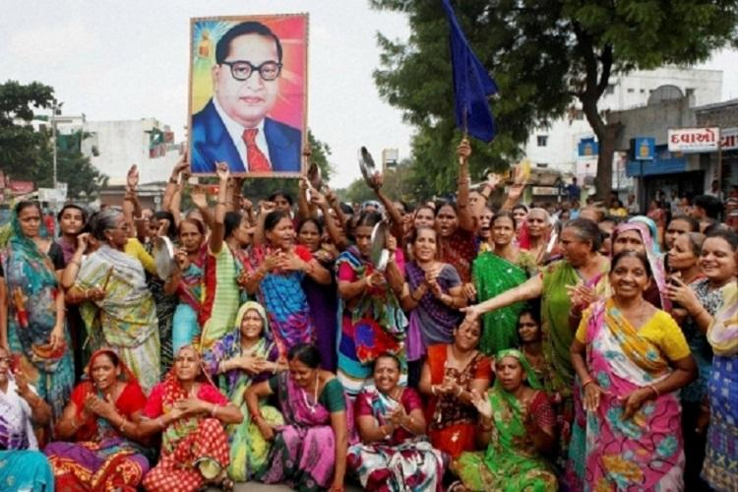
Ambedkar Buddhism of modern India (II)
‘[The Buddha’s first audience] felt that in him they had found a social reformer, full of the most earnest moral purpose and trained in all the intellectual culture of his time, who had the originality and the courage to put forth deliberately and with a knowledge of opposing views, the doctrine of salvation to be found here, in this life.’
Ambedkar’s The Buddha and His Dhamma, p.131
‘The purpose of [the] Tathāgata [i.e., the Buddha] in coming into the world is to befriend those poor and helpless and unprotected, to nourish those in bodily affliction…to help the impoverished, the orphan and the aged, and to persuade others to do so.’
Ambedkar’s The Buddha and His Dhamma, p.297
Notes:
The image depicts Dalit women, or those of what is often called in India ‘Scheduled Caste’, with a portrait of Ambedkar (image from https://www.thenewsminute.com/article/dalits-who-converted-buddhism-better-literacy-and-well-being-64521). In these communities it is not uncommon to see Ambedkar’s image next to that of the Buddha.
Today fewer than 1% of the population of India’s 1.5 billion population is Buddhist, of whom around 7 million are Ambedkar Buddhists in Maharashtra and a number of northern states. Other Buddhists in India are Nepalese or Tibetan, in the very north of the country, or are from any number of other cultures living in the proximity of important Buddhist pilgrimage sites, such as Bodhgayā and Sarnath.

Slide 9
What about “Engaged Buddhism”?
Key concepts:
suffering – internal or external causes?
cultivation of compassion
interdependence
‘Meditation is not to escape from society, but to see what is going on. Once there is seeing there must be acting. With Mindfulness we know what to do, and what not to do to help.’
Thich Nhat Hanh
(https://plumvillage.uk/)
Notes:
Image: Thich Nhat Hanh in 2006. Photo by Duc, CC-BY-SA2.0 https://en.wikipedia.org/wiki/Th%C3%ADch_Nh%E1%BA%A5t_H%E1%BA%A1nh#/media/File:Thich_Nhat_Hanh_12_(cropped).jpg
For a very accessible book on this movement see Paul Fuller, An Introduction to Engaged Buddhism, Equinox 2021. As Fuller makes clear, engaged Buddhism also has a darker side – forms of Buddhist political and military engagement that are ethnocentric or protectionist. Buddhist persecution of the Rohingya people of Myanmar is one example of this.

Slide 10
The 14 Precepts of “Engaged Buddhism” As formulated by Thich Nhat Hanh and used as the basis for ordination of his followers from 1966
12. Do not kill. Do not let others kill. Find whatever means possible to protect life and prevent war.
13. Possess nothing that should belong to others. Respect the property of others, but prevent others from profiting from human suffering or the suffering of other species on Earth.
9. Do not say untruthful things for the sake of personal interest or to impress people. Do not utter words that cause division and hatred. Do not spread news that you do not know to be certain. Do not criticise or condemn things of which you are not sure. Always speak truthfully and constructively. Have the courage to speak out about situations of injustice, even when doing so may threaten your own safety.
10. Do not use the Buddhist community for personal gain or profit, or transform your community into a political party. A religious community, however, should take a clear stand against oppression and injustice and should strive to change the situation without engaging in partisan conflicts.
Notes:
You can see the full fourteen precepts here https://www.lionsroar.com/the-fourteen-precepts-of-engaged-buddhism/
More on the Community of Interbeing and its social activism approach to practice can be found here https://plumvillage.uk/

Slide 11
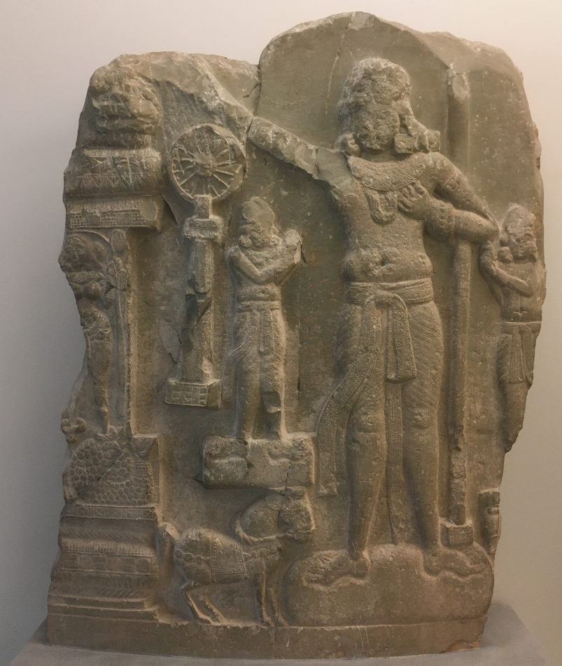
Conclusion
Although the Buddha of pre-modern Buddhist literature does not seem foremost concerned with societal ills, there is no doubt that Buddhists have long sought to make his teachings applicable to real world problems – whether this be at the level of personal morality, of endemic societal injustice, or faced by new challenges in the globalized twenty-first century.
Right: Depiction of an idealized Buddhist ‘universal emperor’ (cakravartin) from Amaravatī, South India, ca. C1st BCE– C1st CE. Musée Guimet, Paris.
Notes:
The image is a relief from Amaravatī, South India, and perhaps the century before or after the year zero (currently exhibited at the Musée Guimet, Paris – picture by Chris Jones, and can be used for educational purposes). It depicts not the Buddha, but seemingly the Buddhist concept of a cakravartin (Pāli cakkavatin), literally ‘wheel-turner’, and ideal ruler (sometimes translated loosely as ‘universal emperor’). The idea of a cakravartin is particularly ancient in Buddhist tradition, and refers to a model ruler who might emerge in the world to complement the ideal teacher who is the Buddha. Various kings and emperors in Buddhist history, in India and elsewhere, have sought to present themselves in this mold.

