Slide 1
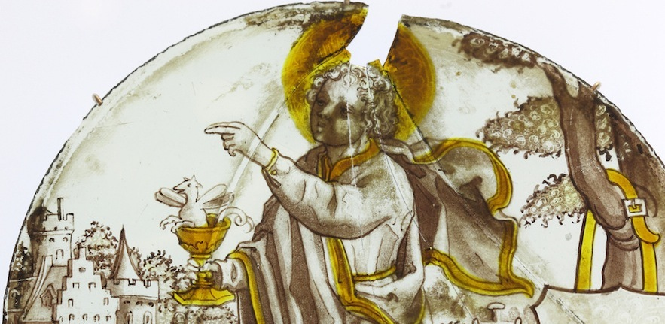
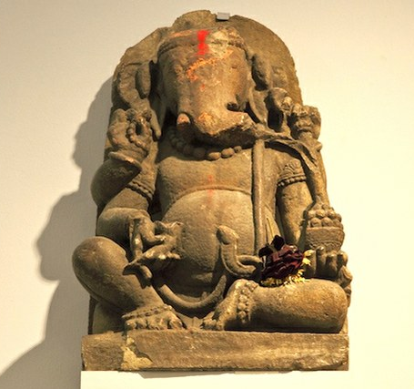
Studying Theology and Religious Studies at university
Laura Jeffrey
Outreach Officer, Faculty of Divinity
Notes:
Please use this slide show to find out more about studying Theology and Religious Studies at university. Delivered June 2014. If you wish to repurpose any part of this talk, please credit the original.
Quotes are from current and recently graduated Theology and Religious Studies graduates from the University of Cambridge.

Slide 2
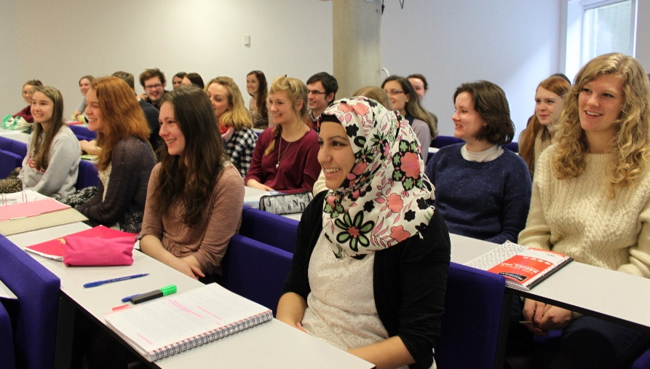
Introduction
Why Theology and Religious Studies (TRS)?
Who studies TRS?
Where should I study TRS?
Why is TRS a valuable subject?
What can I do with TRS?

Slide 3
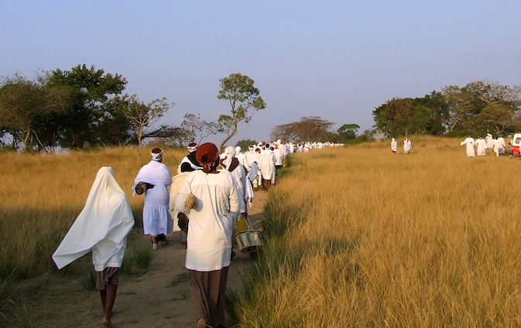
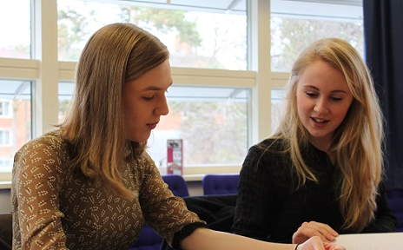
Why Theology and Religious Studies?
Highly relevant to society
Critical and thought provoking subject
Interdisciplinary area
“It has been a challenging, stimulating and mind broadening experience, in which I have been helped and encouraged to develop my own ideas and skills and pursue my own interests, and which I have absolutely loved.”

Slide 4
Interdisciplinary subject area
TRS
Philosophy
Literature
Classics
History
Languages
Sociology
Science
Anthropology
Politics

Slide 5
Diverse interests
Recent dissertations have included:
Religion and Revolution: What made the Muslim Brotherhood so successful in the Egyptian Arab Spring?
Can the Nicaraguan revolution of 1979 be regarded as a Christian Revolution?
Metrical Psalmody in England and Wales, 1530-1630.
The Tragedy of Faith in 'The Brothers Karamazov’.
Happiness as 'The Realisation of Desires' in Anna Karenina.
Halakhah and Organ Transplantation: Past and Present Perspectives and Debates.
Religious aspects of delusions in schizophrenia.
Conflict or Conciliation? The Visual Theology of Northern Irish Sectarian Folk Art.
Grappling with God: A reappraisal of Elie Wiesel's 'protest theology' through an exploration of narrative form.
Exploring the relationship between religion, myth and society in Hindi cinema with particular reference to Mother India (1957), Jai Santoshi Maa (1975) and Lage Raho Munna Bhai (2006).

Slide 6
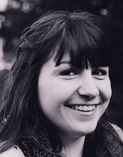
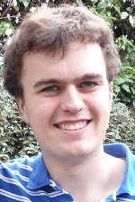
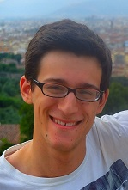
Who studies TRS?
There are no required subjects at A-level/IB/Highers
Many undergraduates have studied arts and humanities subjects such as History, English or Modern Languages but some come from a science background
You do not need to have studied Religious Studies or Philosophy before
You do not need to be religious; students come from all faiths and none
You do need to demonstrate an interest in the issues taught at degree level through wider reading, attending talks, and/or relevant extra curricular activities

Slide 7
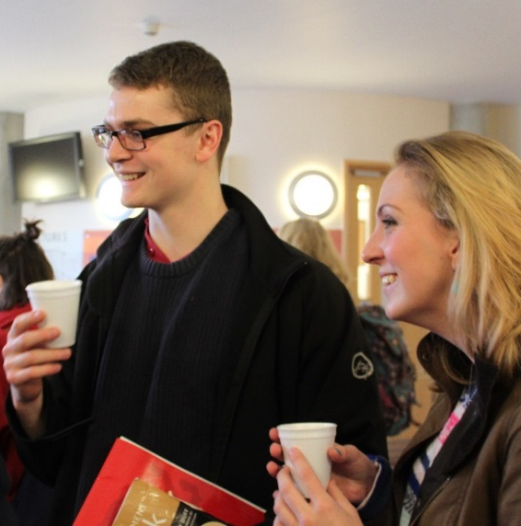
Where should I study TRS?
Consider
Course descriptions
Module choices
Teaching and examination methods
Resources: libraries, lecture theatres etc.
Academic interests of a department
Non-subject based reasons
“A brilliant opportunity to develop your interests (even ones you didn't know you had) in a supportive environment with the best resources available.”

Slide 8
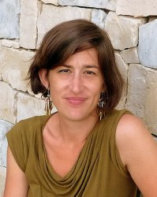
Research informs teaching
Joel Cabrita’s research is on the history of Christianity in Southern Africa. She is currently writing the transnational history of an influential Christian faith healing movement called Zionism. The movement initially took its name from Zion, Illinois. By the late nineteenth century, Zion teachings had spread across the world. “Studying World Christianities in the Faculty of Divinity challenges easily pre-conceived notions of Christianity as a Western religion. Instead, students’ detailed look at the phenomenon of World Christianity shows that Christian adherents in Africa, Asia, Latin America and the Pacific World are rapidly becoming vital players in the social, cultural and political landscapes of their regions.”
She teaches The Rise of Pentecostalism, 1900 to the Present day
Today, the fastest-growing type of Christianity is Pentecostalism, currently numbering 500 million adherents across the world. Neither a creed nor an institution, Pentecostalism is a broad renewalist movement that propels adherents to seek the purifying work of the Holy Spirit in their individual and communal lives. A worldwide phenomenon from its earliest days, Pentecostalism’s centre of gravity now lies decidedly in the Global South: in Africa, Asia, the Pacific and Latin America.

Slide 9
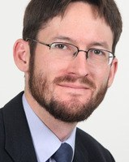
Nathan MacDonald’s research is on the Old Testament.
“When we read any biblical book, we hear not a monologue, but a multi-faceted conversation carried on over generations of scribes. They had not one author, but several; not one edition, but several. Add to this the fact that there are 39 books in the Hebrew Bible and we have an amazing piece of literature, quite unlike anything else.
But this is not even to include the many other fascinating aspects of Old Testament that also enter the picture: comparison to ancient myths and legends, knowledge of the ancient history of Egypt and Mesopotamia, the many archaeological finds, the varied ways in which the Old Testament has been interpreted over the centuries… working on the Old
Testament is a constant journey of discovery, and one in which students can participate in from their first day.”
He teaches One God? Hearing the Old Testament. Belief in God as it is presented ('heard') in the Old Testament is fundamental to Judaism, Christianity and Islam. This course involves both the study and comparison of selected texts and consideration of archaeological and textual evidence from the ancient Near East. The intention is to be both theological and rooted in the history of religion and literature.

Slide 10
Catherine Pickstock’s research is the area of Philosophy of Religion.
“I came to study Philosophical Theology via a degree in English Literature, and in particular through a desire to understand better the relationship between literary form and metaphysical content in such texts as the fourteenth century poem, "Pearl", and Milton's "Paradise Lost". My research falls into three main areas:
The application of linguistics to theories of religious language, analogy and liturgy,
A critical consideration of postmodern philosophy
A reconsideration of the Platonic tradition in interaction with the Biblically based faiths”
She teaches Philosophy of Religion and Ethics. The first part focuses upon philosophy of religion and introduces first year undergraduates to the major themes and problems for language, knowledge and being which arise at the intersection between philosophy and theology. The second section of the paper is aimed to introduce students to the main ethical positions, from Joseph Butler, to moral sense theory, deontology and Kierkegaard's "teleological suspension" of the ethical.

Slide 11
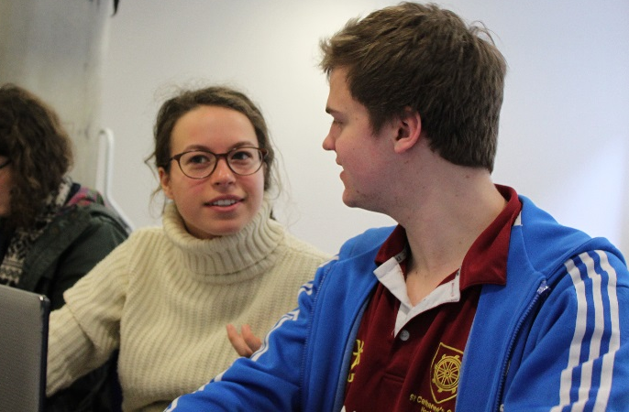
Why is TRS is a valuable subject?
Subject specific elements
Transferable arts and humanities skills

Slide 12
Transferable skills developed by TRS
Improve your investigative, analytical and critical evaluation skills
Sift, select and retain complex information and identify key issues
Express ideas clearly through essay writing and discussion
Hone time and priority management skills
Tackle new languages from scratch
Use imagination and creativity
Take a disciplined approach to problem solving
Critically approach contemporary issues
Understand and take a sensitive approach to different cultures and beliefs

Slide 13
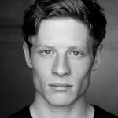
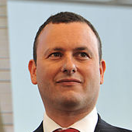
What can you do with TRS?
High number go on to postgraduate education in Theology, associated subjects, teacher training and law conversion
Strikingly broad range of careers
“I hope to do either conflict resolution or international aid and use the Arabic I have learnt here. The degree has greatly improved my self-discipline, confidence to pursue my ambitions and developed my linguistic/ essay writing skills.”
Notes:
James Norton (actor) , Philippa Boardman (Canon Treasurer at St Pauls), Matthew Gould (British Ambassador to Israel)

Slide 14
Recent destinations of graduates
Non-governmental organisations
Crisis Action (New York), Advocacy Associate
Bede House Association, Assistant Domestic Violence Caseworker
The Retinoblastoma Society, National Co-ordinator
Teaching
University of California, Teaching Assistant
University of Oxford, Lecturer
Teach First, Teacher of Religious Education
Arts
Evangelical Alliance, Head of Media
Film, television and stage Actor
Concert pianist
Religion
St Georges Church, Pastoral Assistant
The Methodist Church, Probationer Minister
London School of Economics, Chaplain
Business
HSBC Bank, Executive Management Trainee
Eversheds, Trainee Solicitor
EON, Corporate Management Graduate Trainee
Public sector
Crown Prosecution Service, Case Progression Officer
HM Treasury, Civil Service Fast Stream
London Borough of Islington, Social Worker
Houses of Parliament, Entry Researcher
Foreign and Commonwealth Office, Fast Stream

Slide 15
Alumni careers
I chose to read Theology at Cambridge knowing that the transferable skills acquired would prepare me well for a range of future careers. Like many 18-year-olds, I did not know what career I wanted to pursue at the time of my university application, so I chose to read TRS purely on the basis of academic interest. I thoroughly enjoyed the programme and would highly recommend it to those considering applying.
Prospective and current students of TRS should know that the doctrine of transferable skills can be your best friend: doing a degree in Theology and Religious Studies does not mean that you are destined for the Church or academia. Learning how to think, research, write, structure an argument and communicate effectively are fundamental skills that are essential to the vast majority of jobs.
Jamie
Undergraduate 2007-2010
Crisis Action, New York

Slide 16
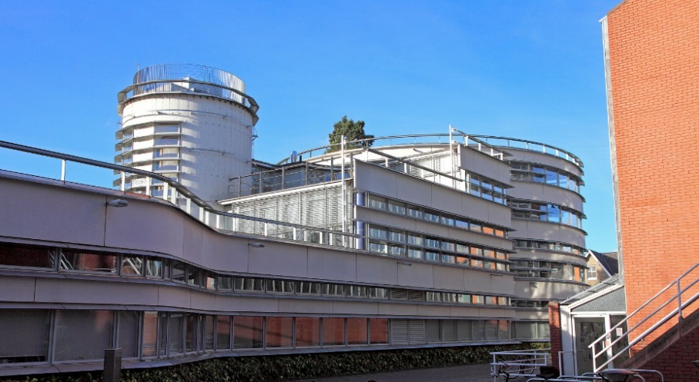
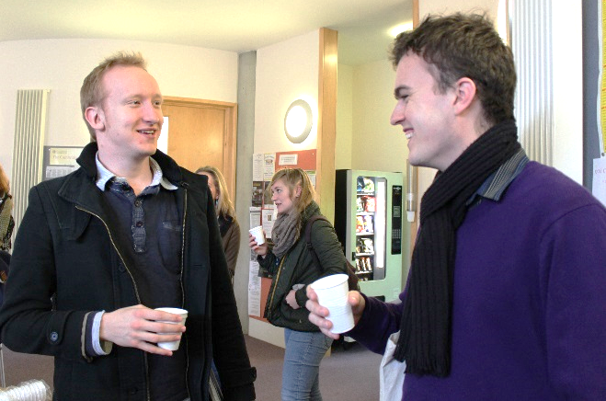
Next steps for students
Talk to teaching staff
Visit universities
Attend open days
Talk to current students
Read web and printed literature

Slide 17
Theology and Religious Studies:
“Challenging, thought provoking, exciting!”

